Slide 1
Partners in Accreditation:
_
Supporting Tribal Health Departments for Public Health Accreditation
David Stone, Education Specialist
NIHB Public Health Summit
May 31, 2012

Slide 2

Session Objectives
At the end of the session, participants will be able to:
List the seven steps in the accreditation process.
Describe at least three ways Tribal Health Departments can support their communities through accreditation.
Explain the link between quality improvement and accreditation.

Slide 3

What is Accreditation?
The measurement of performance against a set of standards.
The issuance of accreditation status by a nationally recognized entity.
The continual development & revision of public health standards.
Image: FreeDigitalPhotos.net

Slide 4
Accreditation Themes
Quality Improvement
Community Engagement
Planning
Leadership & Governance
Partnerships
Customer Focus
Workforce Development

Slide 5
The Public Health Accreditation Board (PHAB)
PHAB is a non-profit, voluntary accreditation organization founded in 2007 whose goal is to advance public health performance by providing a national framework of accreditation standards for Tribal, state, local, and territorial health departments.
Located in Alexandria, VA, PHAB is the national organization charged with administering the public health accreditation program.

Slide 6
Public Health Agency Accreditation System Implementation
Approved August 2010
Inputs
Strategies
Outputs
Short-Term
Outcomes
Intermediate
Outcomes
Long-Term
Outcomes
PHAB Strategies:
Market program
Implement program
- Train agencies
- Review application and
documentation
- Conduct Site visit
- Determine accreditation
status
- Write and share report
Develop database
Evaluate program and
improve quality
Promote research
PHAB Resources:
Organizational
structure
Board, committees
and work groups
Staffing and expertise
Information system
Standards, measures
and guidance
Assessment process
Site visitors
Strong, credible and sustainable accreditation program in place
Improved identification and use of best practices
PHAB:
Accreditation
program:
marketed,
implemented,
evaluated and
improved
Database
developed
Strengthened public health agencies and systems
Increased consistency in practice
Increased science base for public health
Improved conditions in which people can be healthy
Improved quality of services
Increased ability to communicate work and results
Increased inter-agency and inter-sectoral collaboration
Stakeholder and Partner Strategies:
Promote national
accreditation
Encourage agencies to
seek accreditation
Support agencies
through TA before,
during and after process
Stakeholders and Partners:
Promotion and
support efforts
provided
Research
conducted
External Resources:
Funders and partner
organizations
Funding
Incentives
Technical Assistance
Increased support for accreditation
Improved community health indicators
Increased visibility of public health agencies
Increased use of benchmarks for evaluating performance
Increased public investment in public health
Public Health Agencies:
Interest, buy-in and
commitment to seek
accreditation
Appropriate stability,
resources and level of
readiness to apply
Previous quality
improvement and
assessment
experience
Public Health Agency Strategies:
Participate in training
and TA opportunities
Submit application
Conduct self-
assessment
Host site visit
Review findings
Share results
Develop and implement
improvement plan
Implement QI
Participate in
reaccreditation process
PH agencies more effectively and efficiently use resources
Public Health Agencies:
Agencies are
accredited
Report/results
received and
acted on
QI efforts are in
place
Plans for
reaccreditation
underway
Increased public recognition of public health role and value
Increased organizational accountability
Strengthened organizational capacity and workforce
Increased knowledge of organizational strengths and weaknesses
Legend
Accrediting Agency
Individual Public
Health Agencies
Stakeholders and
Partners
Public Health Field
Improved responsiveness to community priorities

Slide 7
Public Health Agency Accreditation System Implementation
Approved August 2010
Inputs
Strategies
Outputs
Short-Term
Outcomes
Intermediate
Outcomes
Long-Term
Outcomes
PHAB Strategies:
Market program
Implement program
- Train agencies
- Review application and
documentation
- Conduct Site visit
- Determine accreditation
status
- Write and share report
Develop database
Evaluate program and
improve quality
Promote research
PHAB Resources:
Organizational
structure
Board, committees
and work groups
Staffing and expertise
Information system
Standards, measures
and guidance
Assessment process
Site visitors
Strong, credible and sustainable accreditation program in place
Improved identification and use of best practices
PHAB:
Accreditation
program:
marketed,
implemented,
evaluated and
improved
Database
developed
Strengthened public health agencies and systems
Increased consistency in practice
Increased science base for public health
Improved conditions in which people can be healthy
Improved quality of services
Increased ability to communicate work and results
Increased inter-agency and inter-sectoral collaboration
Stakeholder and Partner Strategies:
Promote national
accreditation
Encourage agencies to
seek accreditation
Support agencies
through TA before,
during and after process
Stakeholders and Partners:
Promotion and
support efforts
provided
Research
conducted
External Resources:
Funders and partner
organizations
Funding
Incentives
Technical Assistance
Increased support for accreditation
Improved community health indicators
Increased visibility of public health agencies
Increased use of benchmarks for evaluating performance
Increased public investment in public health
Public Health Agencies:
Interest, buy-in and
commitment to seek
accreditation
Appropriate stability,
resources and level of
readiness to apply
Previous quality
improvement and
assessment
experience
Public Health Agency Strategies:
Participate in training
and TA opportunities
Submit application
Conduct self-
assessment
Host site visit
Review findings
Share results
Develop and implement
improvement plan
Implement QI
Participate in
reaccreditation process
PH agencies more effectively and efficiently use resources
Public Health Agencies:
Agencies are
accredited
Report/results
received and
acted on
QI efforts are in
place
Plans for
reaccreditation
underway
Increased public recognition of public health role and value
Increased organizational accountability
Strengthened organizational capacity and workforce
Increased knowledge of organizational strengths and weaknesses
Legend
Accrediting Agency
Individual Public
Health Agencies
Stakeholders and
Partners
Public Health Field
Improved responsiveness to community priorities

Slide 8

What Should a Tribal Health
Department be Doing?
Source: Kozzi Images

Slide 9

Getting Started…
Set the right frame of mind…
It’s about better service
It’s about QI
It’s about doing it well, not fast
Image: Ambro / FreeDigitalPhotos.net

Slide 10

Initial Steps
Get the department organized
Educate about accreditation
Learn the Standards & Measures
Understand the process
Source:Balaraman, FreeDigitalPhotos.net

Slide 12
Framework of the Standards
Domains
Standards Measures Documentation
Guidance
Significance & Purpose

Slide 13
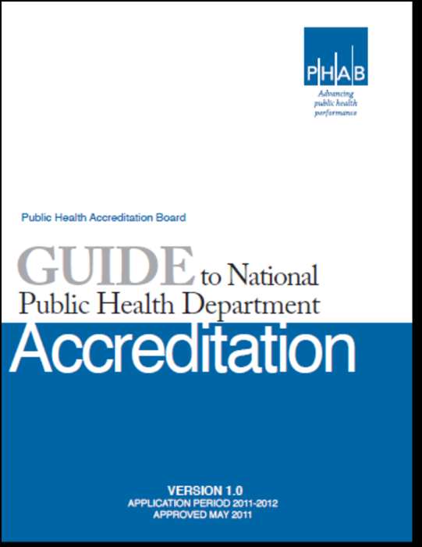

The PHAB
Accreditation
Process
Source: jscreationzs, FreeDigitalPhotos.net
Notes:
Go thru the orientation

Slide 14
Accreditation Seven Steps
1. Pre-application
  Applicant prepares and assesses readiness, informs PHAB of its intent to apply (SOI)
2. Application
  Applicant submits application and pre-requisites and receives training
3. Documentation Selection and Submission
  Applicant gathers and submits documentation
4. Site Visit
Documentation review, site visit and site visit report
5. Accreditation Decisions
PHAB Accreditation Committee determines accreditation status:
Accredited (5 years)
or Not Accredited
6. Reports
Annual progress reports
7. Reaccreditation

Slide 15


Step 1 - Pre-application
Determine Eligibility
Readiness Checklists
Online Orientation
Register on
Statement of Intent (SOI)

Slide 16
Step 2 - Application
Three prerequisites
Letter of support
Electronic signature
Eligibility to apply
Applicant training

Slide 17
Step 3 - Documentation
Must be complete within 12 months
Use guidance in the Standards & Measures document
All staff may play a role
PHAB conducts a review
Completed online through

Slide 18
Step 4 - Site Visit
Conducted by trained peer reviewers
Teams of 3 to 4 with a team chair who will manage the site visit
Site visit scheduled at a practical and agreed upon time
2-3 days with set agenda
Report due 2 weeks after visit

Slide 19
Step 5 - Accreditation Decision
Written notification to health department
Two possible decisions
  Accredited or Not accredited
Accreditation lasts 5 years
If not accredited,
Accreditation Action Plan due within 90 days

Slide 20
Step 6 – Reports
Step 7 - Reaccreditation
Substantial changes
Lists how Opportunities for Improvement are being addressed
Advance notice
Must complete the full accreditation process

Slide 21

Why
Accreditation?
Source: Kozzi Images

Slide 22

Accreditation = Capacity
Engages the workforce
Builds and strengthens partnerships
Fosters performance improvement
Builds on the use of data and EBP
Provides evidence of accountable use of resources

Slide 23

Accreditation
& QI
Source: Miles, FreeDigitalPhotos.net

Slide 24
QI is the Accreditation Cornerstone
Accreditation of the health department is one important step on the journey to creating a culture of quality improvement in public health.

Slide 25
Transformation Through
Accreditation and QI
Set focus on a vital few priorities
Create a sense of urgency for measurable results and a culture of quality
Engage every employee
Build QI time into daily workload
Adopt fact-based decision making
Ensures transparent accountability
Reward and celebrate progress

Slide 26

Current
Status
& the
Future
Source: Miles, FreeDigitalPhotos.net

Slide 27
Current Status
76 health departments in the system
Preparing for site visits this summer
Accreditation Committee trained
Developing several e-PHAB modules
Two applicant cohorts
Trained site visitors

Slide 28
Future Development
Standards and measures revision process
First awards of accreditation
Refinement of the review process based on evaluation and psychometrics

Slide 29
Questions
?
?
?
?
?
?
?
?
?
?
?
?
?
?
?
?

Slide 30
Public Health Accreditation Board
David Stone, Education Specialist
Public Health Accreditation Board
1600 Duke St. Suite 440
Alexandria, VA 22314
703-778-4549 ext 105
703-778-4556 fax
703-203-5061 mobile
www.phaboard.org

